Slide 1
CSE 583 Presentation: where2charge
Arsalan Esmaili
Soheil Keshavarz

Slide 2





Description
$
We developed a charging recommendation tool, which is different from what is available
COMPONENTS:
Back end: data analysis and suggesting the best charging stations
Front end: an interactive map where user can get reliable EVCS suggestions and their routes
USERS:
EV drivers
Policymakers
Researchers

Slide 3





Data
NAME | INFORMATION | PURPOSE | SOURCE
Charging Station | Charging station location, type, and number of plugs in each station | Finding plugs counts and location
EV adoption | Registered EVs by census tract | Finding number of registered EVs
Census Tracts | Census tracts’ geographical information | Mapping the corresponding census tract for each plug

Slide 4

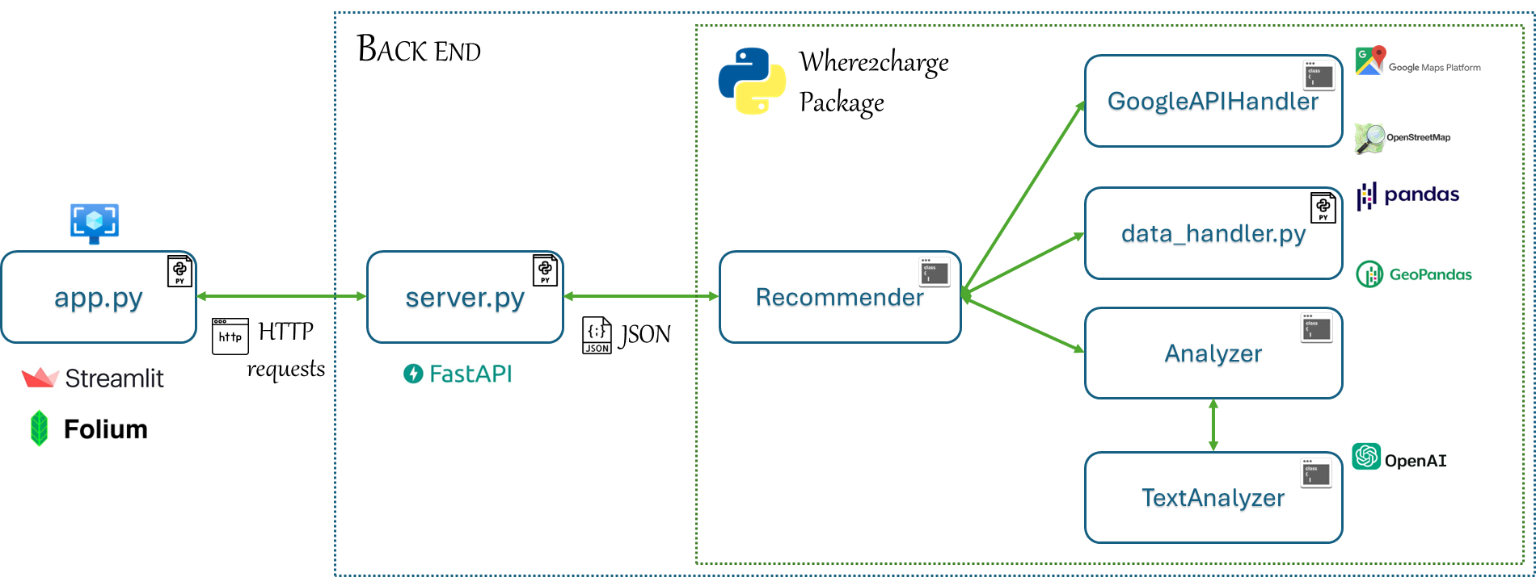

Project Structure and Technologies
Client-server architecture
Mix of procedural and object-oriented programming

Slide 5

Project deliveries
A package
An API
An APP

Slide 6

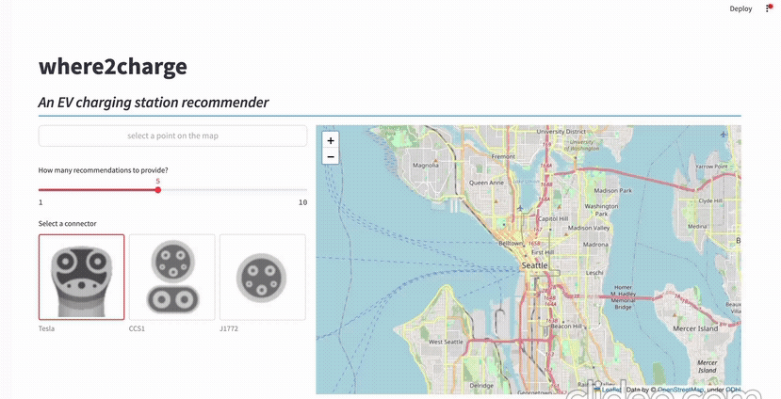
Application Demo

Slide 7

Challenges
BEING FAST AND RELIABLE:
We needed to speed up data query and processing.
Moved from OSMNX to googlemaps package
Google Place API is not providing all possible information of EVCSs
DOE data is not comprehensive enough to match Google queries
To transfer data from logic to UI, we needed to use JSON format
Streamlit does not render immediately after our clicks
Could not perform continuous integration (CI) for security reasons
Oop

Slide 8


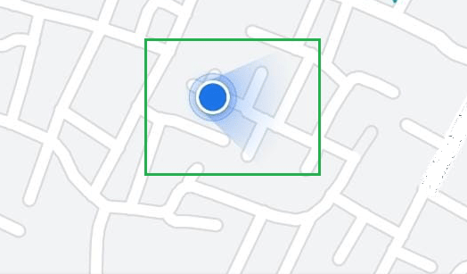


Future work
Deployment:
Make UI more user friendly and smartphone compatible
Implement live location detection
Implement feedback and user data collection functions
Deploy on cloud (AWS)
Data analysis:
Use more data for decision making
Collect data from actual users and fine tune LLM

Slide 9
Act as an electric vehicle owner who wants to charge their EV based on data provided for each EV charging station.
# Steps
1. Read the input data that is provided for a number of EV charging stations.
2. Assess each charging station's available data
3. Offer the rankings of given charging stations.
# Inupt
The input is formatted as a JSON file with key-value pairs. The key for each pair is the index of the entry, and the entry data is the value of the pair.
Each data entry has the following attributes for one EV charging station:
"Review score": Average score of reviewers on Google Maps. If no review is submitted, it is zero.
"Rating count": Number of reviews submitted on Google Maps
"Reviews": shows user reviews on Google Maps with their writer Names
"Travel_Time": travel time from our current location to this entry in minutes
# Output Format
Provide a dictionary with same keys as the input and values show their ranking. The value of each key is an integer between 1 and number of input EV charging stations. No two values should be identical. The lower the value, the more desirable the corresponding EV charging station is.
# Example
input:
'{"0":{"Review score":0.0,"Rating count":0,"Reviews":"[\'No reviews found.\']","Travel_Time":"6 mins"},"1":{"Review score":1.0,"Rating count":1,"Reviews":"[\'William Gibbs: One star because ALL chargers at this location are out of service (as of mid-May 2023)\']","Travel_Time":"7 mins"},"2":{"Review score":3.0,"Rating count":4,"Reviews":"[\'Benjamin Lin: Charging here multiple times, no issue until today found a gas car occupied the spot and there are plenty of open lots. I heard some people doing this on purpose. I don\\u2019t know why?\', \'Nick Corcimiglia: Finally working! Volta app is showing \\u201cunknown\\u201d status, station 02 is properly working. It\\u2019s FREE!!\', \'Eric and Laura Sager: One of the chargers at Safeway has been removed, the other is non-functional\', \\"Mariann K. Smith: Charger at Safeway parking lot doesn\'t work.\\"]","Travel_Time":"4 mins"}}'
output:
'{0:2, 1:3, 2:1}'
This output means that the input with the index of 2 is the first EV charging station to go. It makes sense because it has better travel time, reviews, and review scores than other charging stations. On the other hand, index 1 corresponds to the least desirable charging station where the travel time is greater than other stations and it has only one negative review which is worse than having no review at all (the case for the first charger).
# Notes
- The review score for a station with a rating count of zero can be estimated as the average score of all inputs with valid reviews.
- a station with no review is better than a station with only negative reviews and a very low review score.
- if a station has many reviews, the review score is more reliable than a station with only a few reviews.
- only output the suggestion dictionary, with no additional explanation.

